Slide 1

DEPARTMENT OF COMPUTER SCIENCE & ENGINEERING
DATA ANALYTICS (23CST-613)
M.E. – 1st SEMESTER
COURSE COORDINATOR: DR. MANJIT SINGH

Slide 2
Data Visualization
People process information differently, and there are many types of intelligences. According to developmental psychologist Howard Gardner, there are nine types of intelligences, which explain how individuals learn.
One type of intelligence that Gardner coined is spatial, which means picture smart. While most people have a melting pot of different types to help them learn, the use of visuals tends to benefit most people. It gives them a concrete way to understand and organize what otherwise might be too abstract.
Data visualization is a great way to help people literally get the big picture. It shows process and projects in a visual format that pulls people out of the weeds and adds context to their tasks, whether that be with a dashboard, graph or slide presentation.

Slide 3
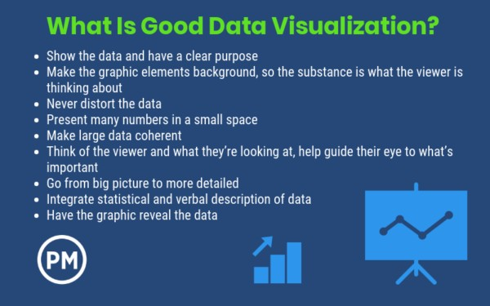

Slide 4
Data visualization is a way to display data in a picture or graphic. It helps people process visually in order to grasp difficult concepts and identify patterns not yet discovered.
This is not a new idea. Think of maps that help people navigate the world. By the 1800s, the pie chart was invented. However, with the invention of the computer and its ability to work with large amounts of data, the use of data visualization can make complex information easier to comprehend.
As a means of communication, data visualization uses statistical graphics, information graphics and other tools for clear and efficient communications.
Qualities of Great Data Visualization
The thing about data visualization is that it’s a blend of art and science. According to Edward Tufte, who wrote the book on data visualization called The Visual Display of Quantitative Information, “Excellence in statistical graphics consists of complex ideas communicated with clarity, precision and efficiency.”

Slide 5
Data visualization has many tools that can be incorporated for communication, such as charts, dashboards, diagrams, drawings, graphs, ideograms, pictograms, data plots, schematics, tables, technical drawings and maps.
Data Visualization and Project Management
Projects, even small ones, can often be complex. There are many variables to control, teams to lead and budget and time constraints to manage. Data visualization can be used as a tool to understand conceptual and idea- development processes. It fosters communication with the project team in a visual language that all can understand.
Some visual tools that can be used in project management include mind mapping, process mapping, storyboarding, root cause analysis, charting, diagramming, graphing, drawing, sketching, wireframing and use cases.

Slide 6
Communication is an overriding concern in every aspect of project management, and data visualization is a great way to communicate clearly and effectively to both teams and stakeholders. While it was normal in the past to use written reports or verbal updates, data visualization has offered a better way to communicate complex information.
For example, there is a project dashboard that can be set up to track the metrics you want to measure and turn those into simple, visually appealing graphs and charts. But the dashboard is only one method, there are also visual ways to report on earned value analysis, make road maps, use Kanban boards in lead methodology or Scrum boards for Agile.
Boost Collaboration
Data visualization also supports a collaborative environment. To get teams to collaborate and better communicate, project managers have used such visual tools and techniques as a project display wall, project collaboration wall, project social media, 3-D project environments, project gamification, etc.
There are many points during a project in which data visualization can help streamline the process. Projects are data-rich environments, and data visualization can help you with the status of a project. You can use it to help disseminate data about project planning, execution, monitoring and even control activities.
Improve Clarity
Data visualization also helps with improving the clarity of the project scope and all operational planning. Resource allocation can also be boiled down to essentials that help decision-making.
And when there is a change to the scope, plan or priority of a project, data visualization helps relay that information in a way that everyone can understand. Plus, these visual materials can be delivered and consumed at times that are convenient for the target audience.

Slide 7
Data management offers at-a-glance views of project status and, if you’re working with an online project management software, real-time project status reporting, issue management and resolution status. With all this data delivered simply, decision-making is also improved.
Old Versus New
The difference between data visualization and more traditional project management information communications is that in the past it was the project manager who pushed communications and determined what was being delivered. The recipient has little say in the matter.
Now, with electronic communications prevalent, the recipient has more control over when they get the information. Rather than a meeting, conference call or email, the data visualization is shared in a common location, which fosters communications between the project manager and the team or stakeholders. The project manager can take the data visualization and target it to the needs of the audience.

